Slide 1
Web3 Data Analytics Sindhu Bommali

Slide 2
agenda
Data preparation & frequency analysis
Advanced frequency analysis
Correlation analysis

Slide 3
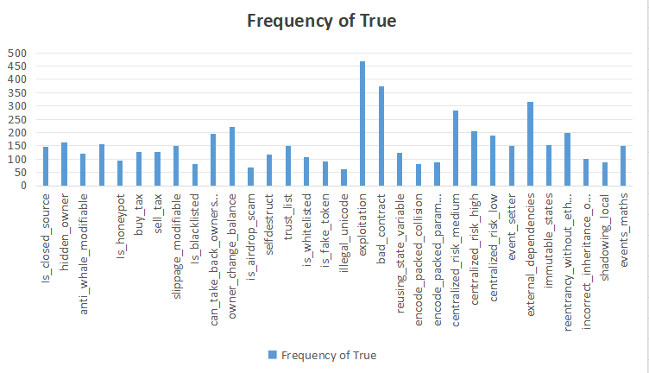
A detailed chart to represent Frequency Analysis of no. of risk tags marked true

Slide 4
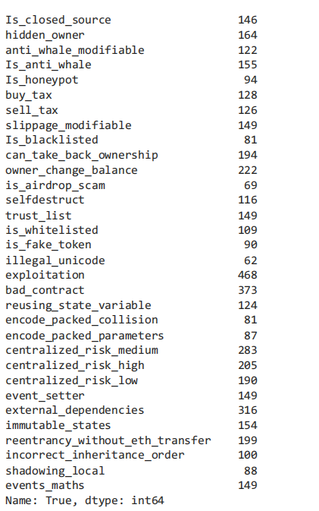
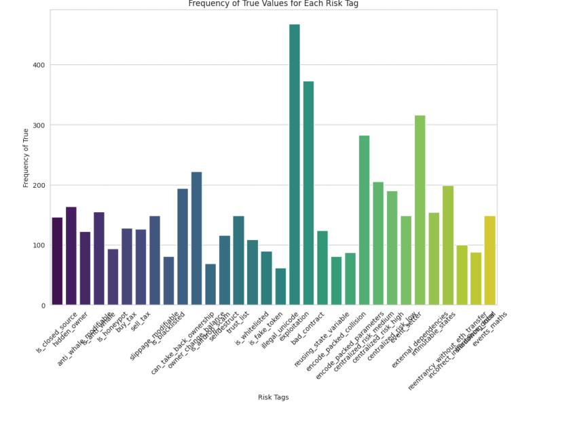
Advanced Frequency Analysis of Smart Contracts

Slide 5
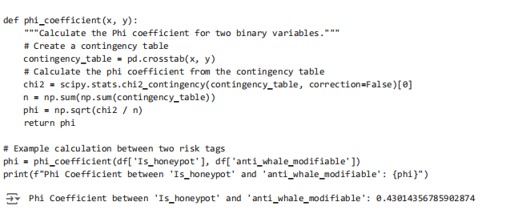
Correlation Analysis of Smart Contracts
calculate the Phi coefficient, which is suitable for pairs of binary variables, we first need to establish a function that can handle this calculation

Slide 6
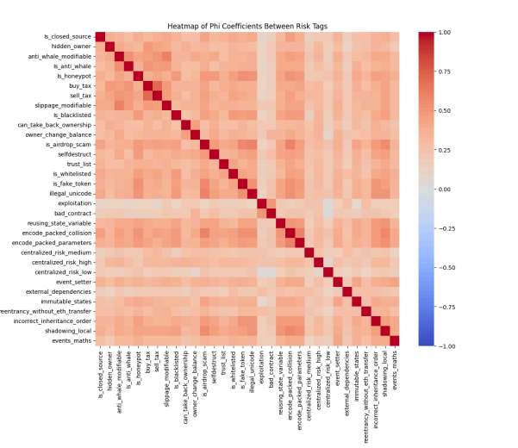
HeatMap Visualization of Smart Contract Risk tags
Though we have the full correlation matrix in front of us, it is very difficult to visualize.
Display those correlations where value is significantly positive or negative.

Slide 7
Thankyou
Sindhu bommali

